Slide 1
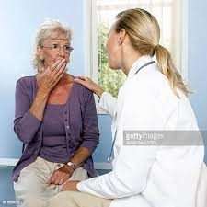
BREAKING BAD NEWS
By
Prof. Nahed hassan
Professor of community medicine and industrial health

Slide 2


Slide 3
Objectives
Define what is breaking bad news
Recognize the challenges for sharing bad news
Apply an effective steps for breaking bad news
How to deliver bad news in the emergency department

Slide 4
What is “Bad News” in Medicine?
Any information that adversely and seriously affects a patients view of their future
Your Bad News may not be my Bad News.
The skills of good communication is needed by all health staff and are easily taught and understood

Slide 5
Examples of bad news in medicine may include:
Traumatic Death
Death after chronic illness
Diagnosis of uniformly fatal chronic illness e.g. Cystic fibrosis
Diagnosis of cancer
Diagnosis of permanent disability or birth defect

Slide 6
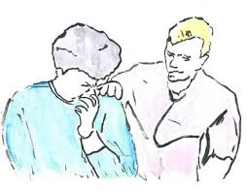
“Bad News” may also include
Unexpected admission to ICU
Long bone fracture
H1N1 influenza
Need for surgery

Slide 7

Breaking Bad News “Options”
Nondisclosure
Full Disclosure
- Give all information
- As soon as it is known
Individualized Disclosure
-Tailors amount and timing of information
- Negotiation between doctor and patient
- As soon as it is known

Slide 8
Patients give priority to
being treated with humanity, dignity and respect
having good communication with health professionals
being given clear information about their condition
receiving the best possible symptom control
receiving psychological support when they need it

Slide 9
Most patients want 2 things
A certain and right amount of information
Opportunity to talk and think about their situation (therapeutic dialogue)

Slide 10
Response of the patients to the bad news
Uncontrollable upset
Angry and shout
Run out of the room
Refuse treatment
Go silent
Start asking difficult question
Give up and die
Commit suicide

Slide 11
Problems affect delivering bad news
Mainly problems in the working environment
Lack of privacy, time and space
Lack of support
Colleagues not perceived as being concerned about patients welfare
Lack of help when needed

Slide 12
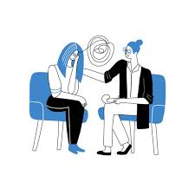
Basic Principles
When to be informed ?
As soon as information is clearly known
Don’t pass on unsure information too soon
Where to be informed ?
Private setting
In person
Support persons present
Both parents
Other support people, family, friends, hospital support

Slide 13
“So you have to do the following :
Ensure Privacy and Adequate Time
Provide Information Simply and Honestly
Encourage Patients to Express Feelings
Discuss all the available suitable Options
Provide Information About Support Services
Document Information Given

Slide 14
How should Bad News be delivered?
A . The 6 Steps Protocol:
1- Getting started (getting the setting right)
2- What does the patient know?
3- How much does the patient want to know?
4- Providing information
5- Responding to patient and family feelings
6- Planning and follow up

Slide 15

How should Bad News be delivered?
Step 1, 2, 3
Preparation
Step 4
Delivering the news
Step 5, 6
Response to patient reaction & care plan

Slide 16

Steps of Preparation
1. Prepare Yourself
2. Prepare Your Setting
3. Prepare Your Patient

Slide 17
Preparation 1. (Prepare Yourself)
Review the patient's history and know about possible management
Practice the interview for possible questions and answers
Relatives can be present, but , follow the patient’s wish

Slide 18
Preparation 2. (Prepare Your Setting)
Arrange to meet in a quiet room.
Make sure that you are not going to be disturbed.
If recently examined allow him/her to dress before the interview.

Slide 19
Preparation 3.(Prepare Your Patient)
Try first to focus on ;
What do they know already?
What do they want to know?
Some patients do not want details
Always build up gradually.

Slide 20
Delivering the News
Always Remember to;
Use simple language, listen, follow verbal and non-verbal cues.
Be at level of understanding and vocabulary of the patient.
Avoid excessive bluntness, it may leave the patient isolated .
Set the tone. e.g. "I am afraid I have some bad news"

Slide 21

Give the information in small sentences
Avoid using hopelessness terms
Be truthful, gentle and courteous
Offer hope
Emphasize the positive
Allow questions.

Slide 22
Response to Reaction & Care Plan
Respond to Patient & Family Feelings
Acknowledge the emotions experienced by the patient and if a patient is silent use open questions, e.g.
"How are you feeling now?“
Allow the patient and family time to express their emotions and let the patient know you understand and acknowledge their emotions.

Slide 23
Don't leave the patient confused
Provide a clear care plan with treatment options
Identify support systems; involve relatives and friends.
Offer to meet and talk to the family if not present.
Make written materials available.
Summarise.

Slide 24
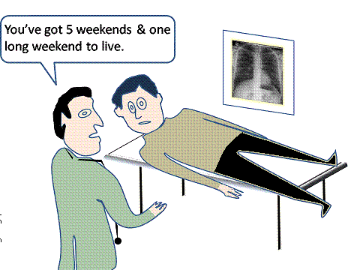
What Not to Do ?

Slide 25
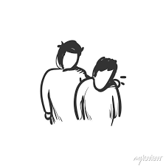
What Not to Do ?
Don’t Break bad news over the phone.
Don’t Avoid the patient.
Don’t Leave patient in suspense.
Don’t Lie to the patient.
Don’t Interrupt excessively.
Don’t Use jargon.

Slide 26
Don’t Give excessive information as this causes confusion.
Don’t Be judgmental.
Don’t Give a definite time span (just say "days to weeks" or "months to years" etc.
Don’t Pretend treatment is working if it isn't.
Don’t Say “Nothing can be done”.

Slide 27
“Breaking Bad News" in the Emergency Department
It is a difficult task because;
Families do not have time to prepare for the bad news.
Practitioners do not have a previous relation with patient or family
A stressful situation for practitioners.

Slide 28
Breaking bad news (Death Notifications) In The Emergency Department
BE READY FOR
Initial reaction of eruption of grief
Reactions are varied according to the culture of the people
Very rarely yet chances of hostile reaction towards the staff
WHAT TO DO?
Physician should stay in room with family:
As a resource
As a silent presence
Remind family members that it was not their fault.

Slide 29
What to do
Gather the family to support them
Identify the deceased patient by name and the knowledge to be disclosed to the family.
Explain to family about the event that occurred for their deceased in the emergency.
Give the family personal space and time for emotional moment and absorb the information.
Ask if there are any questions, answer them all.

Slide 30

Conclusion
Preparation
What does the patient know?
Is more information wanted?
Give a warning shot
Allow denial
Explain (if requested)
Listen to concerns
Encourage ventilation of feelings
Summary –and –plan
Offer availability
Notes:
Lowden (1998)
Disclosure can affect the long-term health of the patient, influencing the way the person adjusts to living with cancer. The studies of psycho-immunology provide evidence for the possible ways in which this can effect survival. It is therefore suggesting that breaking bad news can be a form of health promotion. So lets look at breaking bad news the “ healthy way”

Slide 31
‘The task of breaking bad news
‘if we do it well,
they will never forget us
If we do it badly ,
the patients or family members may
never forgive us

Slide 32


